Slide 1
Object Oriented Analysis & Design Module-5 (RL 5.2.3)
Harvinder S Jabbal

Slide 2
Relationship among Classes in Class Diagram

Slide 3
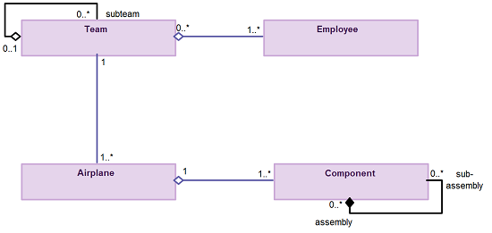
Aggregation and Composition
Aggregation is a specialization of association, highlighting an entire-part relationship that exists between two objects.
Composition is a much potent form of aggregation where the whole and parts have coincident lifetimes, and it is very common for the whole to manage the lifecycle of its parts.

Slide 4
Guideline for
Aggregation and Composition
You should be interested in both the whole and the part
Depict the whole to the left of the part
Apply composition to aggregates of physical items

Slide 5
Inheritance
Inheritance models “is a” and “is like” relationships, enabling you to rather conveniently reuse data and code that already exist.
When “A” inherits from “B” we say that “A” is the subclass of “B” and that “B” is the superclass of “A.”
We have “pure inheritance” when “A” inherits all of the attributes and methods of “B”.
The UML modeling notation for inheritance is usually depicted as a line that has a closed arrowhead, which points from the subclass right down to the superclass.
Plus in the sentence rule for inheritance
Put subclasses below superclasses
Ensure that you are aware of data-based inheritance
A subclass must inherit everything

Slide 6
Relationship
encompass all UML concepts such as
aggregation,
associations,
dependencies,
composition,
realizations, and
inheritance.
if it’s a line on a UML class diagram, it can be considered as a relationship.

Slide 7
Guideline for Relationship
Ensure that you model relationships horizontally
Collaboration means a need for a relationship
Model a dependency when a relationship is in transition
As a rule it is best to always indicate the multiplicity
Avoid a multiplicity of “*” to avoid confusion
Never model implied relationships

Slide 8
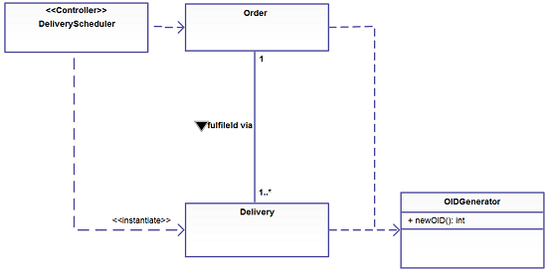
Relationship (Figure A)
Depict similar relationships involving a common class as a tree.
In Figure A you see that both Delivery and Order have a dependency on OIDGenerator. Note how the two dependencies are drawn in combination in “tree configuration”, instead of as two separate lines, to reduce clutter in the diagram.

Slide 9
Guideline for Relationship
Never model every single dependency
Center names on associations
Write concise association names in active voice
Indicate directionality to clarify an association name
Name unidirectional associations in the same direction
Word association names left-to-right
Indicate role names when multiple associations between two classes exist
Indicate role names on recursive associations
Redraw inherited associations only when something changes
Question multiplicities involving minimums and maximums

Slide 10
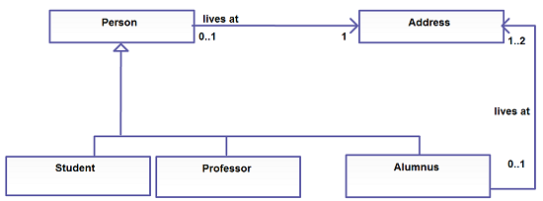
Relationship (Figure B)
Make associations bi-directional only when collaboration occurs in both directions. The lives at association of Figure B is uni-directional.

Slide 11
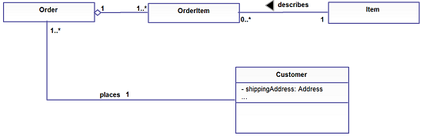
Relationship (Figure C)
Replace relationships by indicating attribute types.
In Figure you see that the customer has a shippingAddress attribute of type Address – part of the scaffolding code to maintain the association between customer objects and address objects.

Slide 12
Acknowledgement
Slides are based on Course Text Books:
Applying UMP and Patterns (An Introduction to Object-Oriented Analysis and Design and Iterative Development) : Craig Larman
UMP Distilled (A Brief Guide to the Standard Object Modeling Langauge) : Martin Fowler
Design Patterns (Elements of Reusable Object-Oriented Software) : Erich Gama | Richard Helm | Rapph Johnson | John Vlissides alias GoF.
http://creately.com/diagram-type/article/simple-guidelines-drawing-uml-class-diagrams

